Slide 1
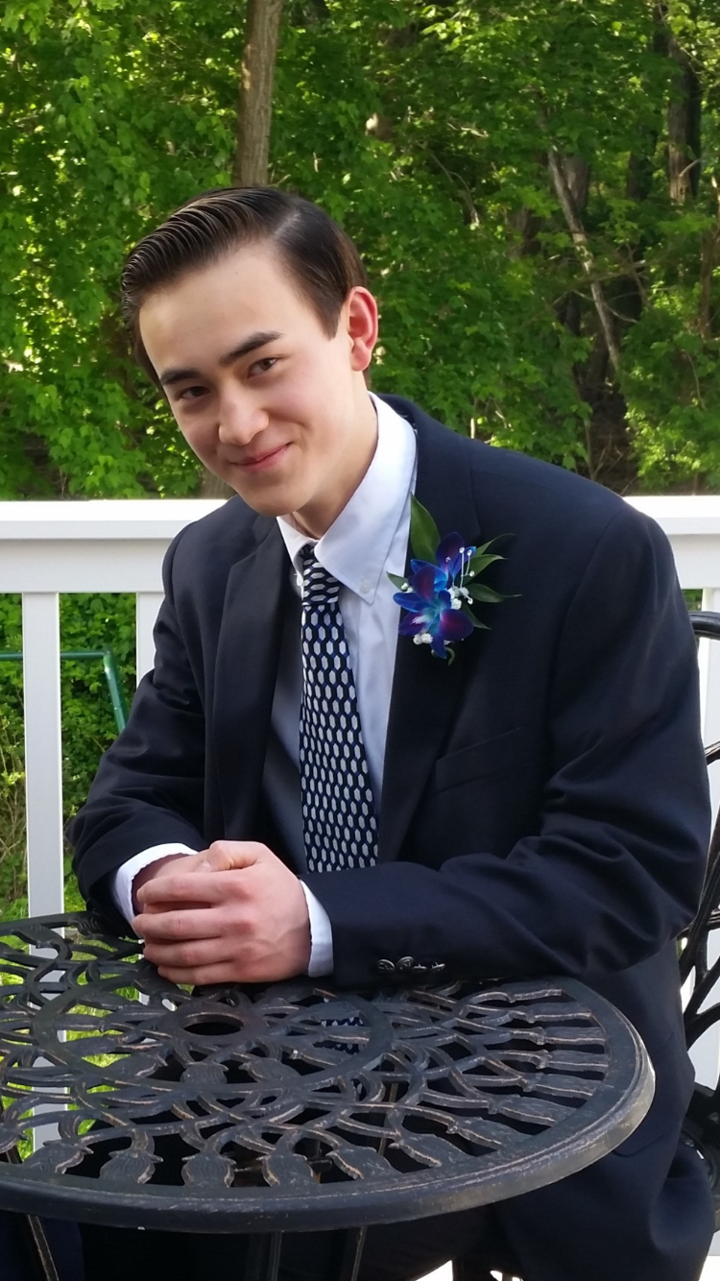
Drone Signal Quality Map
Creating a 3D map using a drone as a mobile receiver
01.13.2017 Presentation
HTHS Fall Mentorship
Karl Roush

Slide 2
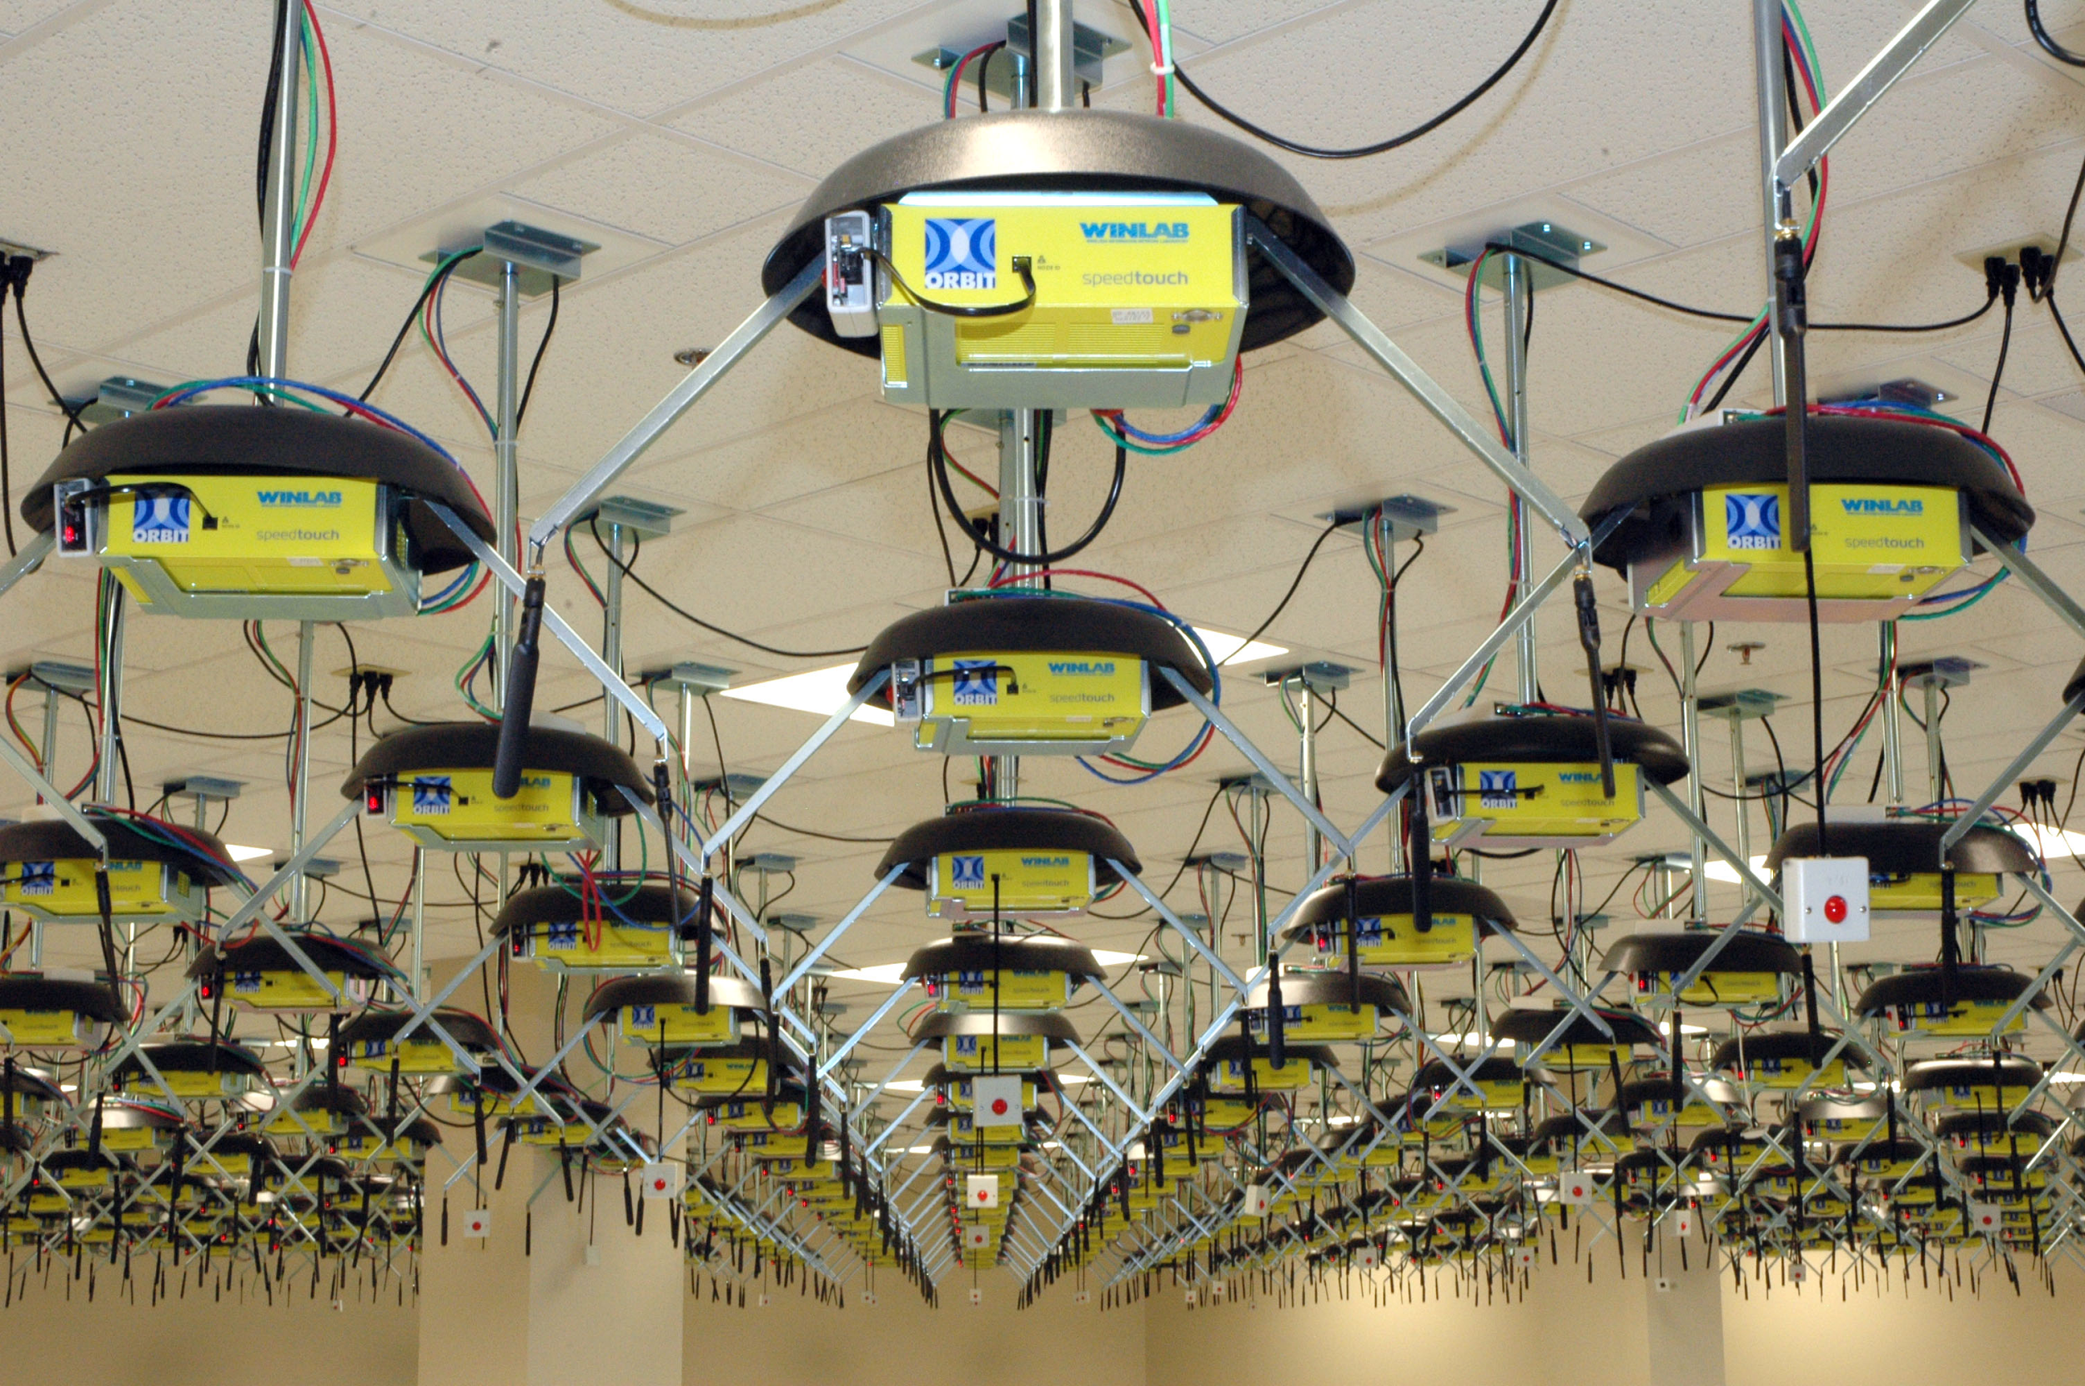
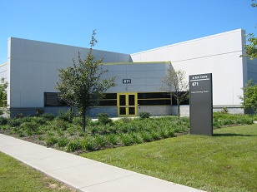

Rutgers Wireless Information Network Lab
Location
Research mission: To advance the development of wireless networking technology by combining the resources of government, industry and academia
Working to address the need for connecting large numbers of people and objects wirelessly
Some problems being worked on:
Scaling wireless system capacity from Mbps/Sq-km to Gbps/Sq-km.
Promoting spectrum efficiency and increased co-existence between unlicensed band services.
Achieving ultralow-latency in wireless access networks.
Educational mission: To train the next generation of wireless technologists via graduate research programs that are especially relevant to industry.
Typically has a pool of ~40-50 graduate and undergraduate students
Most students work on projects that lead to their MS or PhD thesis in either the ECE or CS departments at Rutgers
Runs annual WINLAB Summer Internship Program that offers internships in a university research setting to highly talented high-school, undergraduate and graduate students

Slide 3



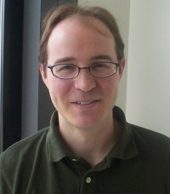
Prof. Wade Trappe, Ph. D
Mentor
Education and Position
B.A. with Highest Honors, Mathematics, University of Texas at Austin, 1994
M.S. Applied Mathematics and Scientific Computing, University of Maryland, College Park, 1999
Ph.D. Applied Mathematics and Scientific Computing, University of Maryland, College Park, 2002
Professor in the Electrical and Computer Engineering Department at Rutgers University
Associate Director of the Wireless Information Network Laboratory (WINLAB)
Previously worked on projects including:
Cybersecurity
Communication systems
Security and privacy for sensor networks
Physical layer security for wireless systems
Development of wireless testbed resources (the ORBIT testbed)
Led a DARPA initiative into validating and prototyping physical layer security mechanisms
Currently leading an Army CERDEC (Communications-Electronics Research, Development and Engineering Center) project on cognitive radio networks and MIMO (multiple input, multiple output) communications.

Slide 4
Project objective
To create a 3D signal quality map using a drone as a mobile receiver carrier
This will be accomplished through the usage of the following:
3DR Solo drone
Courier unit for mobile receiver
Mobile Android device
Continuously stores the signal strength indicator, GPS coordinates, altitude and time in a log file
Octave program
Reads the data from the receiver log files
Plots data points in three dimensions
Fills in the space between data points using custom algorithm
Blue represents successful completion, green represents in progress/pending approval, red represents an unresolved issue

Slide 5
Purposed Design Diagram
Simplified diagram of the various components and their interactions
Drone executes flight path
Flight path is determined
Wireless
Drone completes flight path and lands
Data is processed via Octave offline
Android device records positional and signal data
Notes:
roll= z, yaw= y, pitch= x

Slide 6
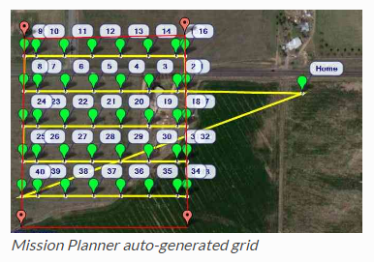
Drone Flight Path
Accomplished through the program Mission Planner
Determined before launch via waypoints
Can also generate an autogrid
Saved to a “mission” file
Uploaded to drone via wireless

Slide 7
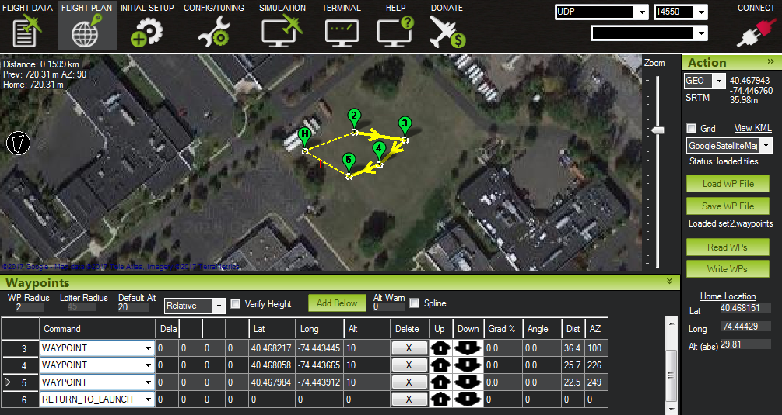
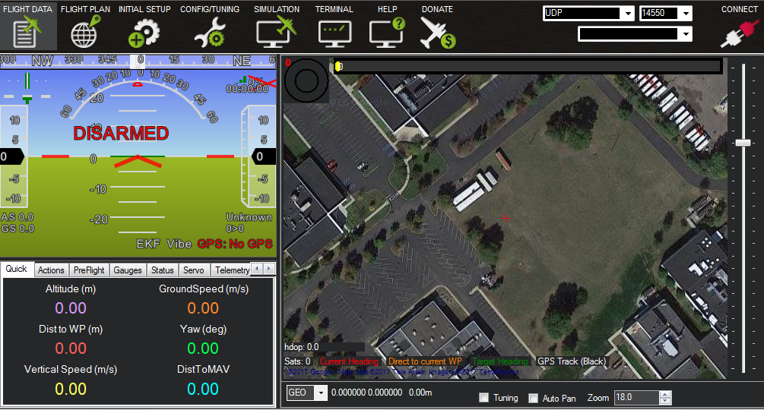
Specific Drone Flight Path
Flight Data Interface (Disarmed)
Test Flight Pattern in Field Across the Street

Slide 8
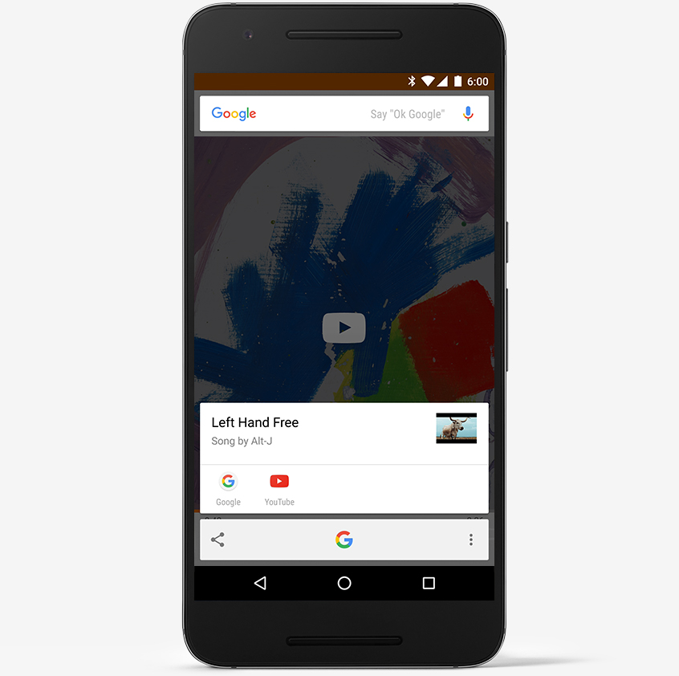
Mobile Receiver Programming
Receiver is an Android device
Linked via LTE to WINLAB base station
Logs signal strength and position at regular intervals
Log program primarily written in Java
Receiver is mounted on the drone
Android device similar to one used

Slide 9
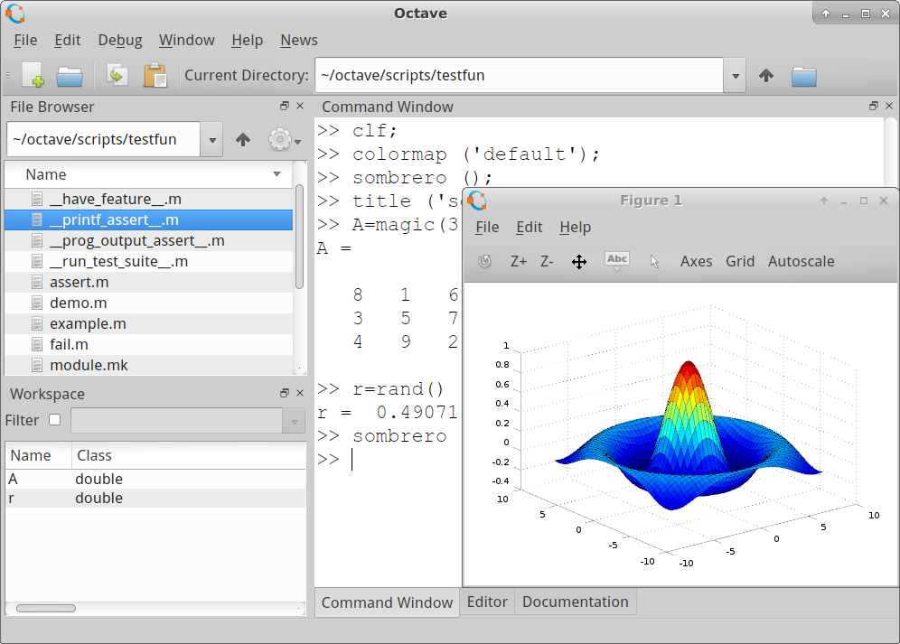
Octave Overview
Programming environment that supports mathematical analysis and visualization of data
Used to provide a graphical interpretation of the data
Allows for custom written interpolation algorithm to fill in the gaps in the data
Sample Octave Interface

Slide 10
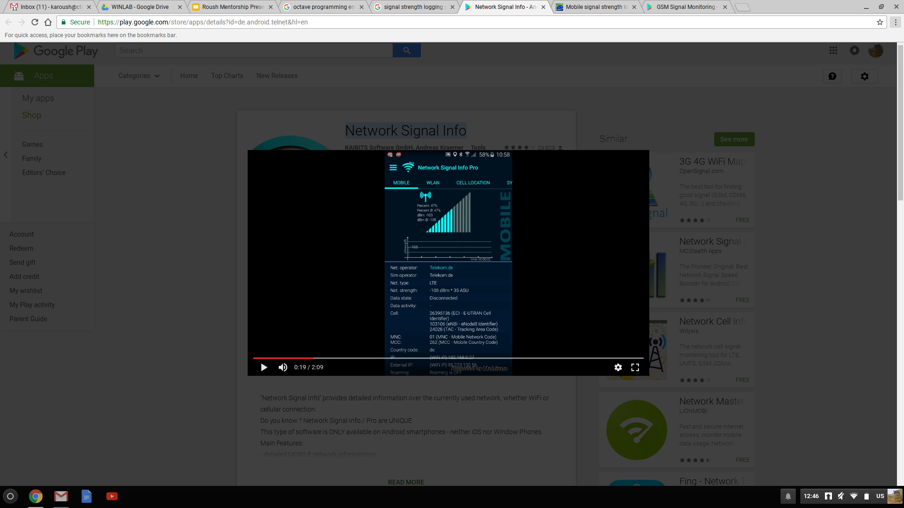
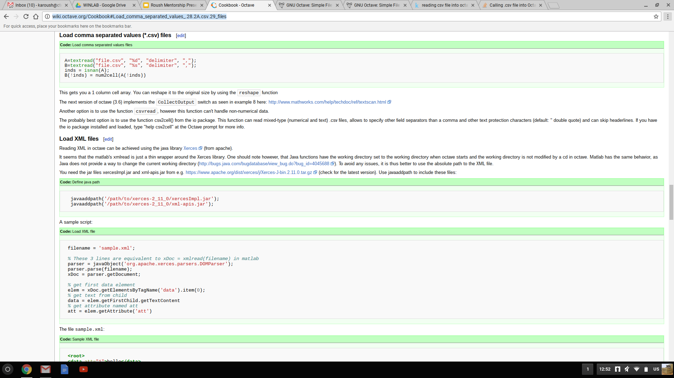
Octave Data Retrieval
App used is called “Network Signal Info”
Data is logged on mobile device in labeled files
Available in app interface
CSV log type
Octave is used to convert these logs into usable data
Octave Code to Read a CSV file into a 1 column cell array

Slide 11
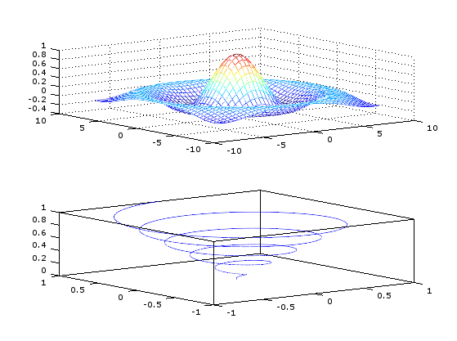
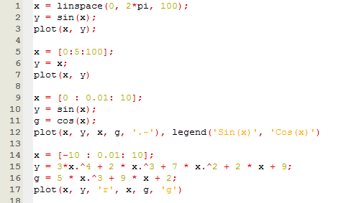
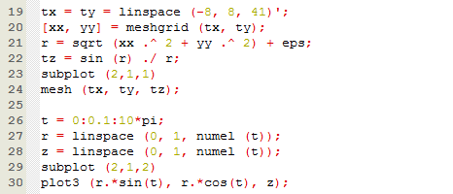
Graphing the Data
Done through “plot” command
Graphing is done through discrete points not functions
Strength is represented by color change (red is strongest, blue is weakest)
Several data types can be placed on one 3D graph
Modified tutorial code and graph produced

Slide 12
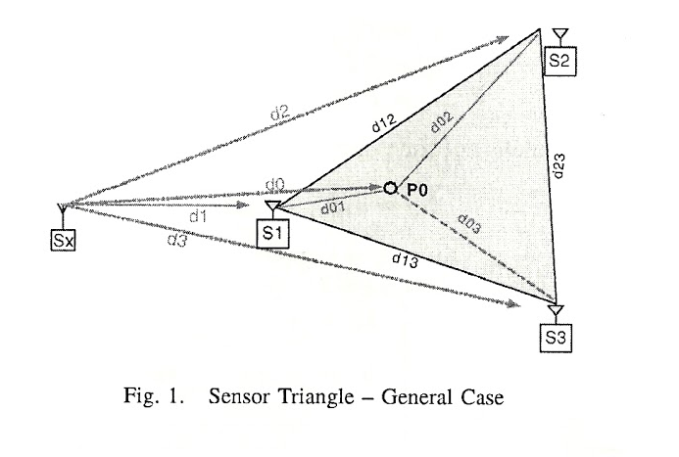
Interpolation Algorithms
Nearest Neighbor
Point is given the value of the closest data point
P0= S1
Inverse Distance Weighting
Point is given value based on distance from nearby data points
P0= ([1/d01]*S1)+([1/d02]*S2)+([1/d03]*S3)
Natural Neighbor
Similar to Inverse distance weighting, but with area

Slide 13
Problems Encountered & Solutions
Lack of prior knowledge
Interpolation algorithms beyond NN
Spoke to Shweta Sagari regarding paper on spectrum cartography
Read other paper (provided) on path loss estimation
Orbit
Completed basic tutorial
Worked on LTE tutorial (SB3 does not have dongle)
Octave
Completed numerous online tutorials
Consulted StackOverflow for specific problems
Talked to Dragoslav Stojadinovic for graphing help
Java
Completed Codeacademy online course
Did several sample projects
General signal principles
Read Wikipedia topics detailed by Prof. Trappe
Watched radio interference conference videos

Slide 14
Problems Encountered & Solutions
SB3- no LTE dongle
Re-run tutorial on node1-1.sb6
Graphing
Representing time, location (x,y,z), strength on one graph
Strength=color, time dynamic
Material/staff availability
Planned ahead of time
Scheduled via email
Regular interval updates

Slide 15
Timeline of Events
September 2016
Discussion of possible project
Read papers on “Transmit Only”
Researched SDR basics
Learned basic interference principles & mitigation techniques
Spoke to Dravoslav who provided additional resources
Project finalized 09.30.2016
October 2016
Refined project definition
Read previous project work
Learned to use SDRSharp
Prepared external Linux boot drive
Downloaded and began learning Octave
Spoke Shweta Sagari about interpolation algorithms
Created project timeline and description
Began programming flight pattern
Began learning graphing concepts in Octave

Slide 16
Timeline of Events
November 2016
Downloaded and installed MissionPlanner
Created alternate flight pattern for testing
Successfully tested flight pattern twice
Update about configuring mobile receiver to WINLAB base station
Continued graphing work in Octave
Dec. 2016- Jan. 2017
Tested first custom written Octave graphing program
Re-installed Octave graphics packages
Created optimized zig-zag flight pattern and saved waypoints
Scheduled mobile receiver usage
Began documentation
Began learning how to use ORBIT
Completed “Basic Tutorial” and SSH
Attempted “LTE Tutorial” on SB3
Outlined Octave final program
Finished documentation

Slide 17
Accomplishment Overview
Proficiency in Octave, Java
Development of efficient flight plan
Creation of Octave data retrieval/graphing program
Deployment of Nearest Neighbor interpolation algorithm to data
Linkage of mobile receiver to ORBIT sandbox node
Gained an understanding of:
Basic wireless transmission and networks principles
Complex interference
Power loss/leakage
Signal encryption
Broadcast overlaps
Increased proficiency in reading research papers and consulting outside references

Slide 18
Deployment and Applications
Project
Career
ID of signal leakage
Optimization of signal output
Ease of troubleshooting
General diagnostics
Mobile and easy to use for above purposes
Aerospace major
Direct:
Drone flight path programing
Reading research papers
Consulting references to learn new material
Coding in a new programing language
Indirect:
Signal decay
SSH
Interpolation algorithms
Signal optimization

Slide 19
Final thoughts
Exposed to a new area of research, but also in an area that I have an interest
Work alongside undergraduate and graduate students
Opportunity to fly a large drone
Learned a great deal in the field of wireless technology
Successful, but could’ve used more time
Very enjoyable experience overall, not just academically
Special thanks to Wade Trappe and Ivan Seskar

Slide 20
Questions?

